Slide 1
BIKES SALES
INDIA

Slide 2
MISSION AND VISION
Mission:
To empower the two-wheeler industry in India with data-driven intelligence by providing accurate, timely analysis of vehicle registration trends, seller behaviors , and regional market penetration. We are committed to helping manufacturers, dealers, and policymakers understand the dynamics of the active and expired vehicle ecosystem, particularly in Tier 3 and metro markets, to drive strategic decision-making and sustainable growth.
Vision:
To become the most trusted and comprehensive platform for two-wheeler market analytics in India, revolutionizing how businesses track vehicle lifecycle, forecast demand, and optimize their strategies across every tier of the market.

Slide 3
DATA DESCRIPTION
STATE
AVG DAILY DISTANCE
BRAND
MODEL
PRICE
YEAR OF MANFACTURE
ENGINE CAPACITY
FUEL TYPE
MILAGE
OWNER TYPE
REGISTRATION YEAR
INSURANCE TYPE
SELLER TYPE
RESCALE PRICE
TIER TYPE

Slide 4
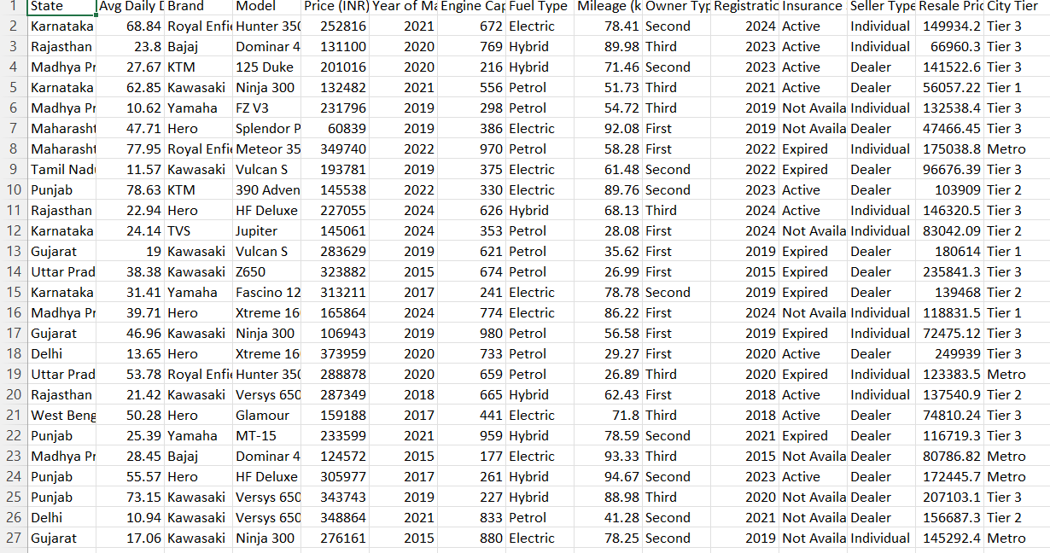
EXCEL DATASET

Slide 5
KPIS AND INSIGHTS
INTRODUCTIONS
This is a bike sales dataset that contains information about various bikes and their features.
By using this dataset, you can analyze important trends related to bike sales
We used by excel to create to visualizations of key performance indicates (KPIs)like sales performance , total cost and region-wise analysics .
TOTAL COST
TOTAL UNITS
2243287224
40
TOTAL SALES
TOTAL STATES
1338289740
10

Slide 6


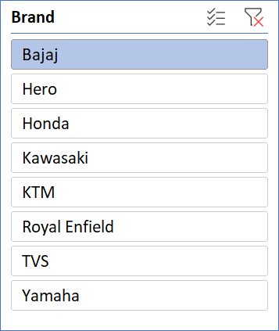
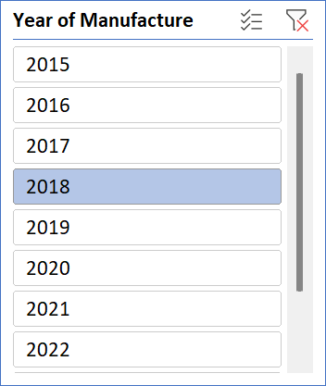
India Bike Sales Analysis
TOTAL COST
TOTAL UNITS
TOTAL STATES
TOTAL SALES
2243287224
40
10
1338289740

Slide 7
thanks!

